Slide 1
Literacy
Activity 8 and 9

Slide 2

How to write a great non-chronological report

Slide 3
Today…
Now you are going to create your own report about an elf or sprite.
Here is a list of suggestions for you to use, but you can always write about your own original idea:
  The forest elf is found in large woods and hedgerows. It has twigs and leaves sprouting out of its head.
  The river sprite lives under riverbanks. It is covered in a salmon’s scales and is very slippery to touch.
  The rose elf inhabits gardens and has red, soft skin. It smells very sweet and likes to sleep in a rose’s petals.
  Lemon tree elves live in grocery departments of big stores and are an astonishing bright yellow. However, they have sour spit which is best avoided.
  The library sprite hides on bookshelves, is pale and, because of reading so much, tends to wear glasses.
  The sky elves live in clouds, can fly with their tiny wings and have misty hair. They are the only species of elf that can fly long distances.

Slide 4
Make up your mind!
Now that you have chosen your creature, try and write a couple of sentences about them using the sentences in the previous slide as a model.
Example
I have chosen to write my report about The coffee sprite. Here are my sentences.
The coffee sprite can be found lurking outside coffee shops and cafes. It can be recognised by its twitching hands and by the speed at which it speaks.

Slide 5
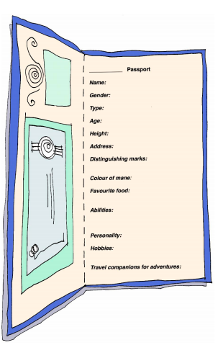
Name: Caffy
Gender: Female
Type: Coffee sprite
Age: Never you mind!
Height: Tall enough to sip an espresso shot
Address: Java House, Mugfullofcoffee street, Caffeineton, Gimmealatte, E5P R3S0
Distinguishing marks: Frizzy mocha coloured hair, wide brown eyes, creamy skin, an incredibly fast talker and very speedy walker! Has an intense stare which can be interrupted with a twitch.
Favourite food: Coffee cake and, if she can get hold of them, the coffee cream Roses sweet! She also loves biscotti and any other biscuit that you can dunk in a cup of hot coffee!
Abilities: Incredibly productive, has super speed, can stay awake for prolonged periods of time.
Personality: impatient, short tempered and abrupt
Hobbies: wiling away the hours in coffee shops pretending to do work when really they are people watching.
Travel companions for adventures: Elf friend ‘Milky’ and her trusty mount ‘Beans’

